Slide 1
WEEK 03 What is Computing? HTML5 Basics
Phase I Web Programming

Slide 2
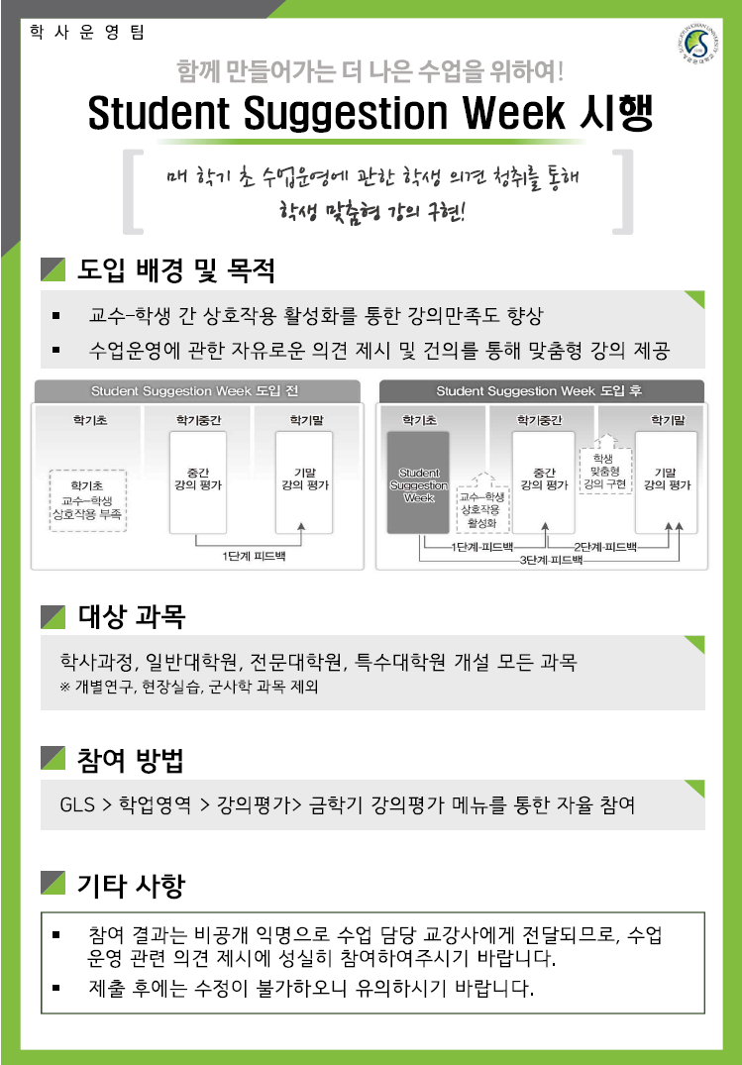
Students Suggestion Week
2019. 09. 16(Mon) 10:00 ~ 09. 27(Fri) 23:00

Slide 3

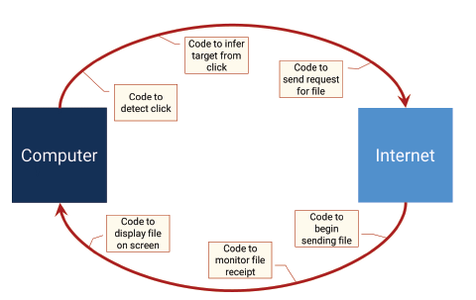
WHAT IS PROGRAMMING?

Slide 4
Internet vs. Web
Internet
network of network (https://cablemap.info/_default.aspx)
an enormous global network of billions of servers, computers, and other hardware devices running Internet Protocol
Each device can connect with any other device as long as they’re both connected to the internet using a valid IP address.
Web
one of the ways to share information on the internet
email, File Transfer Protocol, and instant messaging services
The web is composed of billions of connected digital documents that can be viewed using a web browser.
the collection of public websites connected to the internet worldwide, together with client devices such as computers and cell phones that access its content
The web is just one part of the internet.
The Web is the most popular way of accessing the Internet.

Slide 5
History of the Internet & Web
ARPANET (1969~1990)
Advanced Research Projects Agency NETwork
created with funds from the U.S. Department of Defense
BITNET (1981~1996)
Because It's There NETwork
computer network btw U.S. universities
CSNET (1981~1991)
Computer Science NETwork
formed by the U.S. National Science Foundation

Slide 6
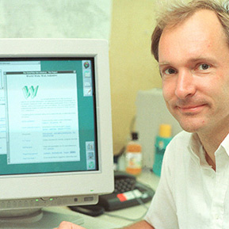
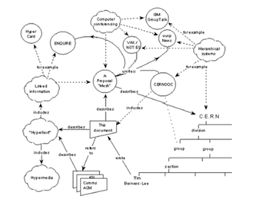
History of the Internet & Web
WWW
“Information Management: A proposal” by Tim Berners-Lee in 1989
to link and access information of various kinds as a web of nodes in which the user can browse at will
Websites and web browsing exploded in popularity during the mid-1990s and continue to be a key usage of the internet today
World Wide Web
the collection of public websites connected to the internet worldwide
source: https://www.w3.org/History/1989/proposal.html

Slide 7


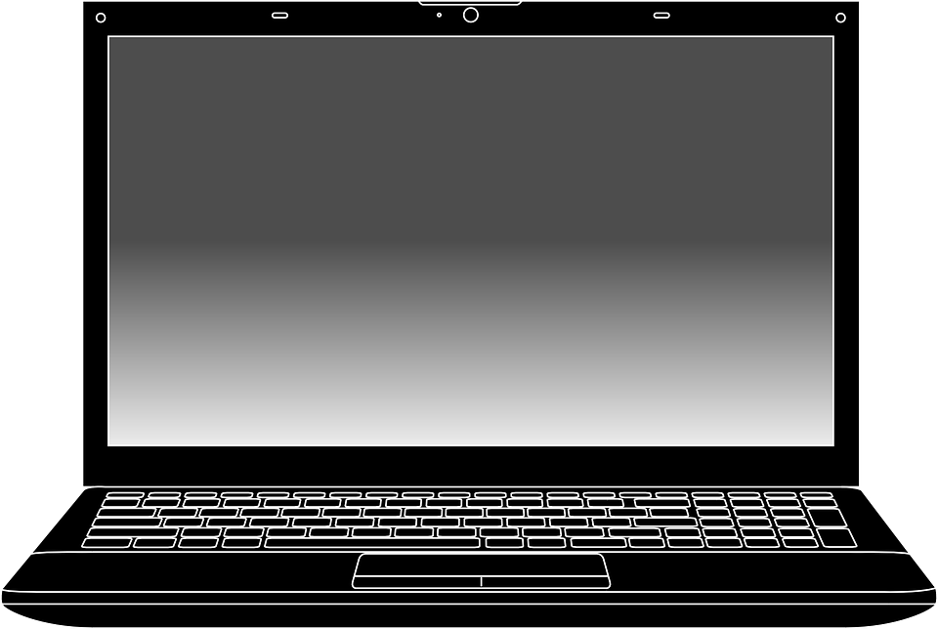

History of the Internet & Web
WWW
three core Web technologies
HTTP
the standard protocol used to request and transmit files on the Internet
HTML
the basic language of browsers
Web servers & Web browsers
client-server system of computer networking
clients request information from servers
server
HTTP
client
HTML

Slide 8
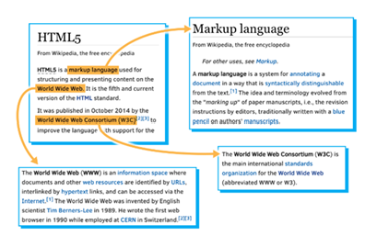
Hypertext
the idea of linking information together
not constrained to be linear
contains links to other texts
to "Mark Up" your document with links and define how to break it down into different segments
Tim Berners-Lee began to create a definition of HTML to provide a simple, uniform way to incorporate Hyperlinks in a text document (1989).
a "Web" of interconnected documents
navigated by a new tool called a "Browser"

Slide 9
Web Browsers
to see end results of your source code
to view your work → open an html file
MS Edge or IE, Firefox, Chrome, Safari, ...
History
WorldWideWeb (1992)
Mosaic (1993)
Netscape Navigator (1994)
Internet Explorer (1995)
Mozilla Firefox (2002)
Apple Safari (2003)
Google Chrome (2008)

Slide 10
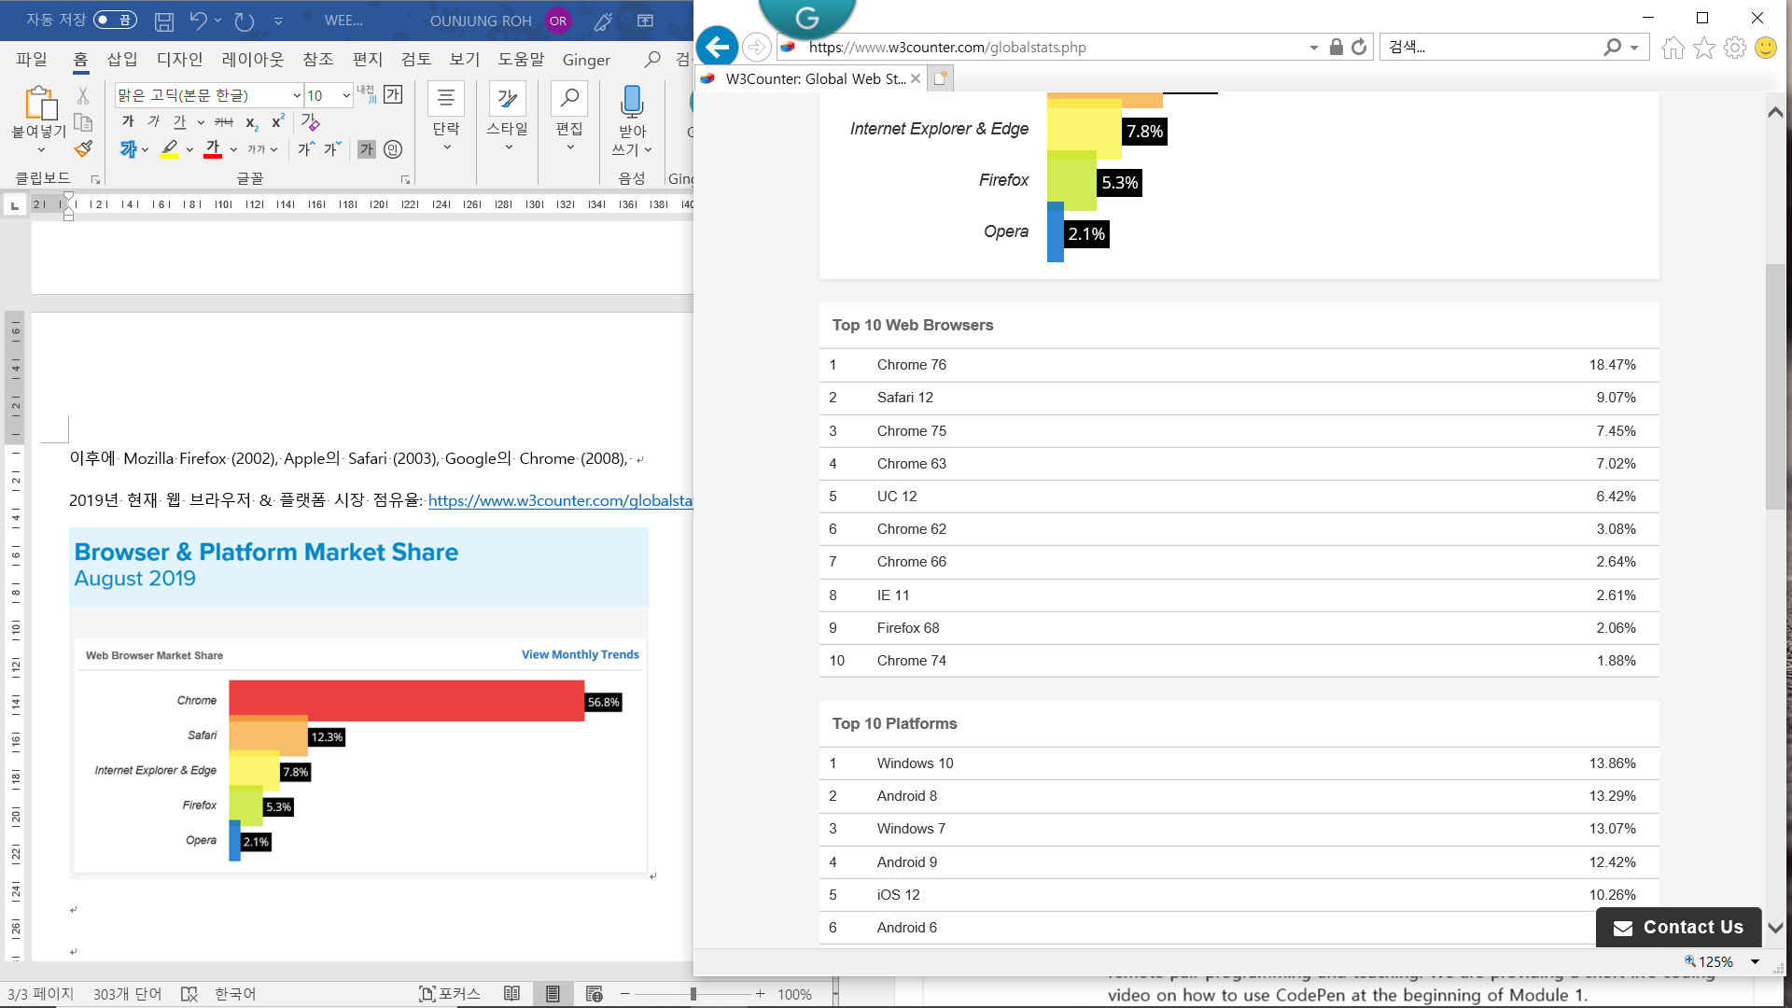
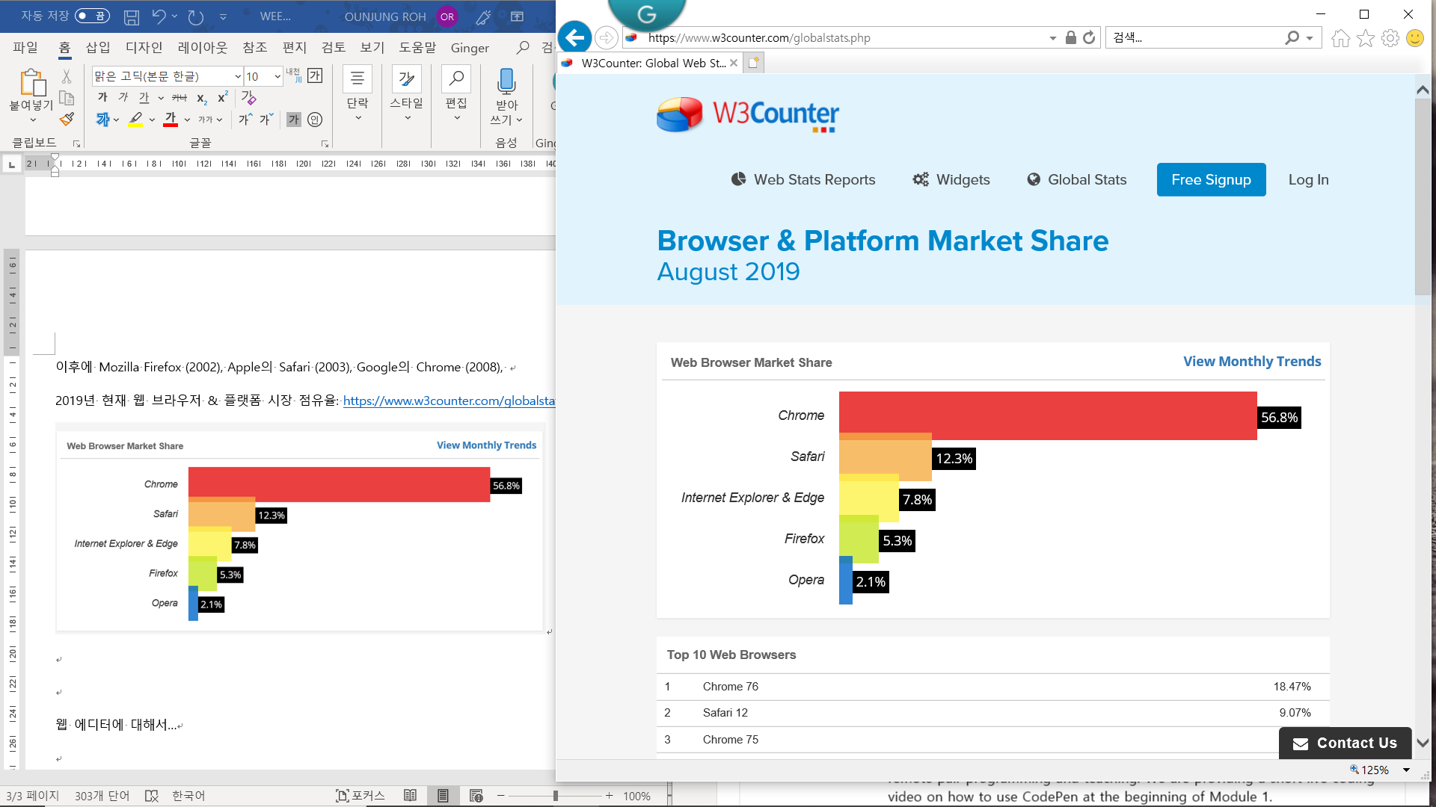
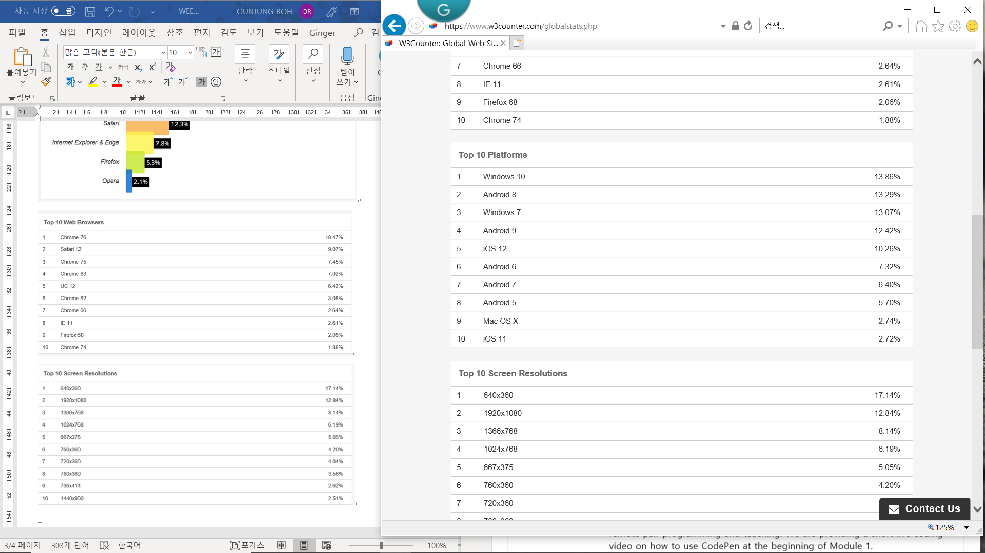
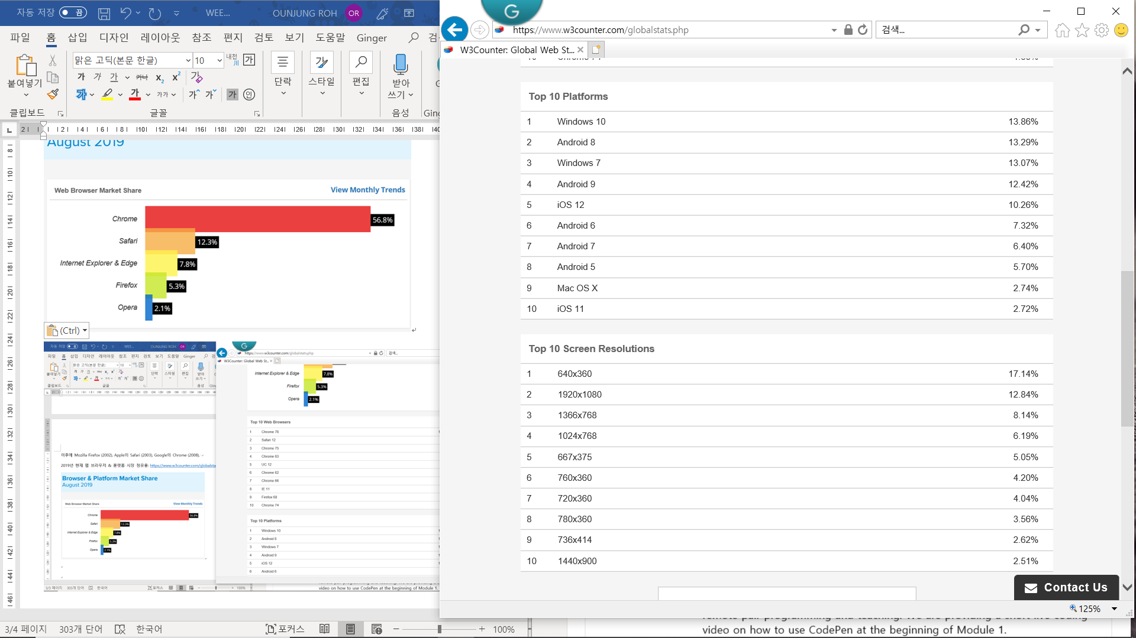
Web Browsers
Browser & Platform Market Share
source: https://www.w3counter.com/globalstats.php

Slide 11
Text Editor
Notepad on Windows, TextEdit on Macs, Xcode on Macs, Visual Studio Code, Sublime text, Atom, BlueGriffon (a WYSIWYG content editor)
online editors: JS Bin (https://jsbin.com/), CodePen (https://codepen.io/)
to support a "plain text" format ('.txt’)
".rtf", ".doc", etc

Slide 12
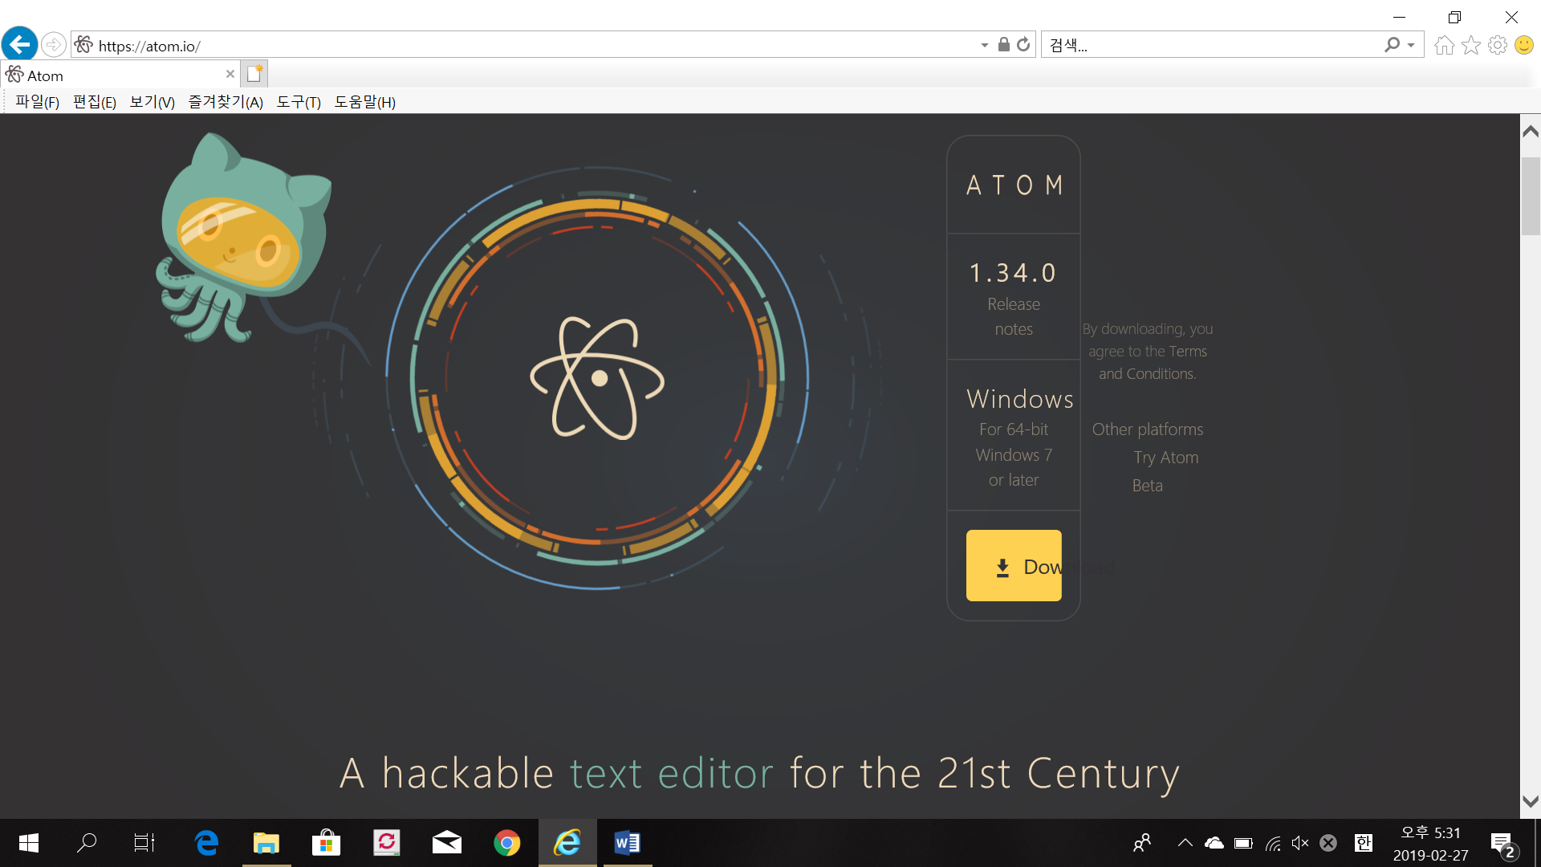
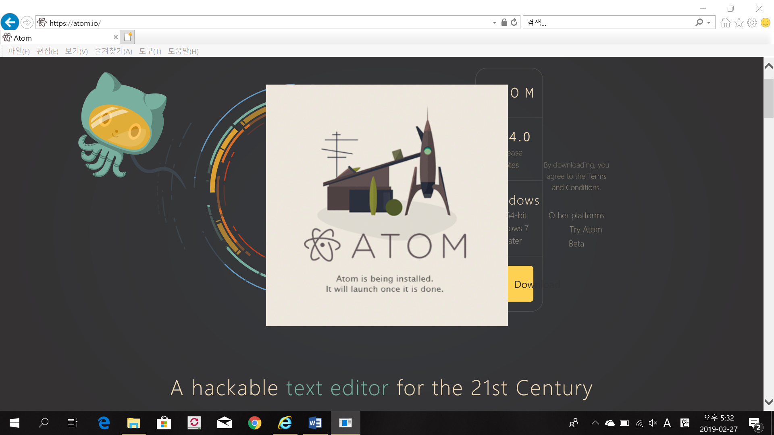
Installation & Setup
https://atom.io

Slide 13

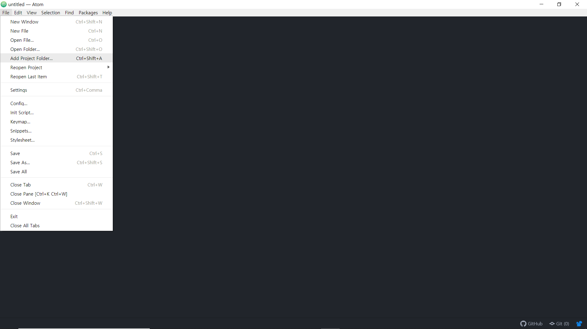
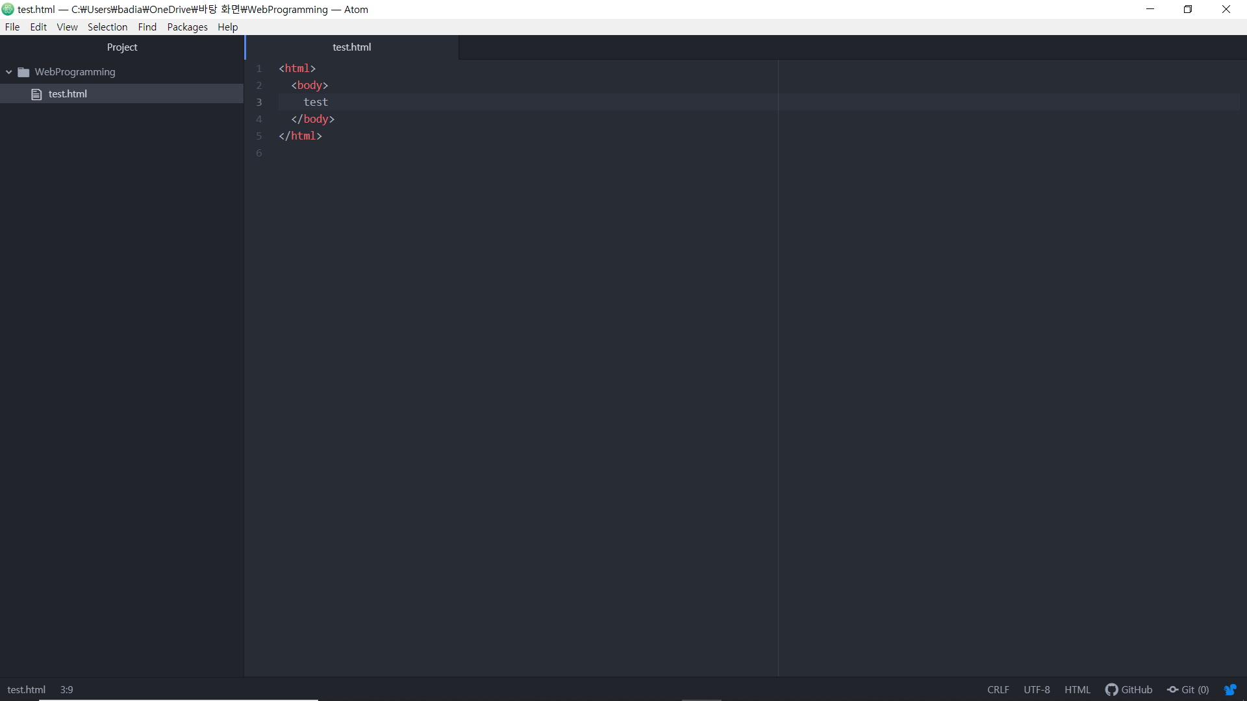
Installation & Setup
Let’s do!
Create a new file in WebProgramming folder.
Open it in your browsers.

Slide 14
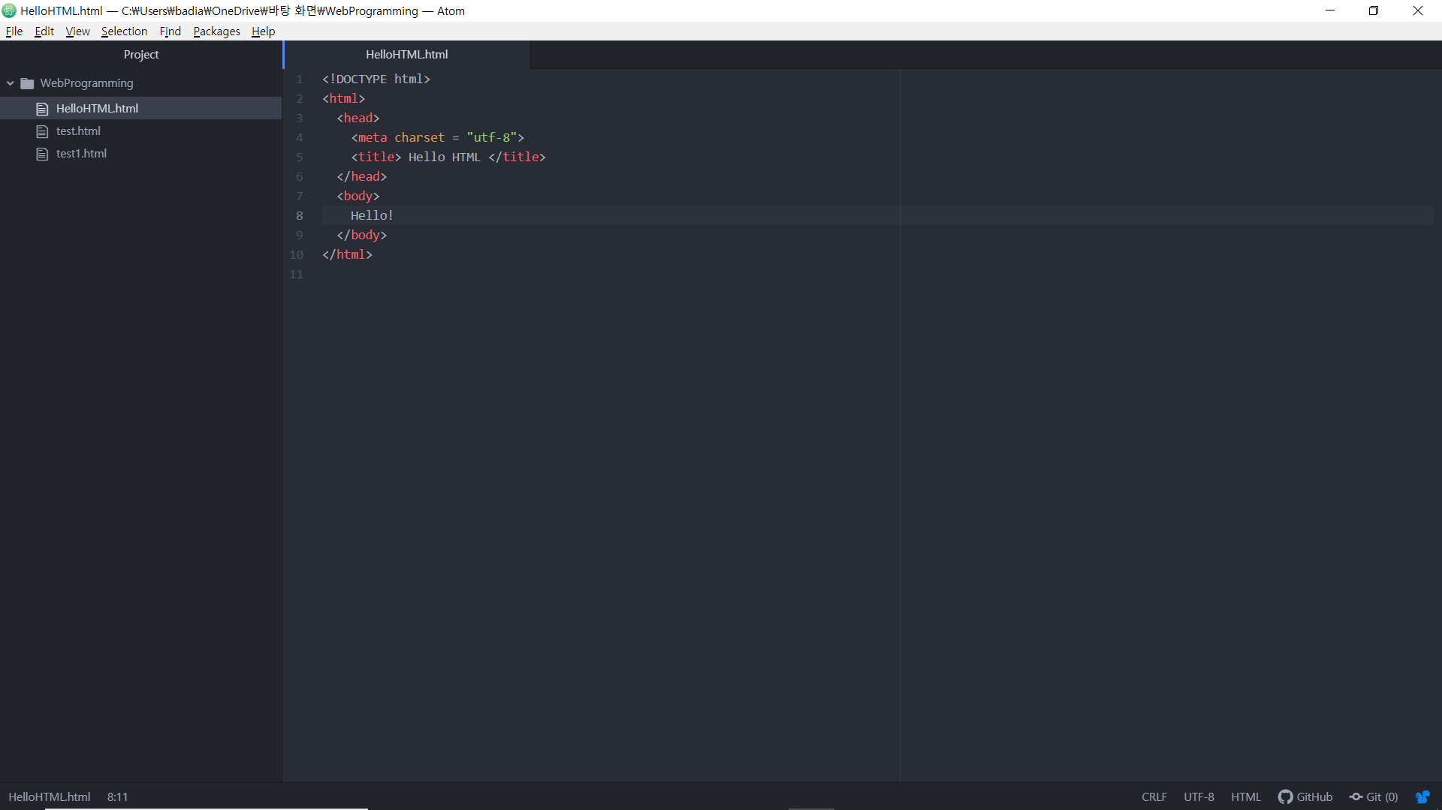
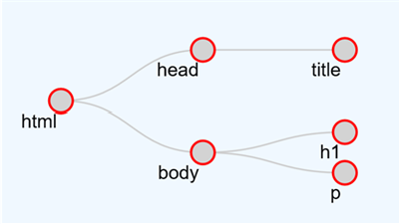
Basic Structure of HTML
Elements
Tree Structure
- Parents, Children, Siblings

Slide 15
Basic Structure of HTML
<!doctype>
Document Type Declaration
<html>
wrap around nearly everything in your html file
<head>
put information that not appear in the body of the work
<body>
all of the content of your page
what the user sees

Slide 16
Character Encoding
Encoding
to assign and store in computer memory in the form of bytes
Examples of character encodings
ASCII: contains letters, characters and a limited set of symbols and punctuation for the English language
Windows-1252 (Latin1): Windows character set that supports 256 different code points
ISO-8859-6: contains letters and symbols based on the Arabic script
Unicode: contains characters for most living languages and scripts in the world
Use the Unicode character encoding UTF-8 for your Web pages.
Save the file in UTF-8 format.

Slide 17
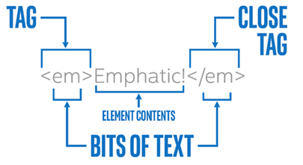
Tags
to organize a text file → a tree of elements that make up the html document
the bits of text you use to tell the computer where an element begins and ends
to determine which parts are "MarkUp" and which parts are the content
by using ‘<tag>’ & ‘</tag>’

Slide 18
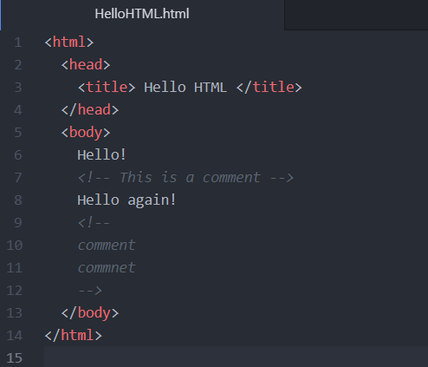
Comments
a way of adding some text that is primarily targeted towards human readers

Slide 19
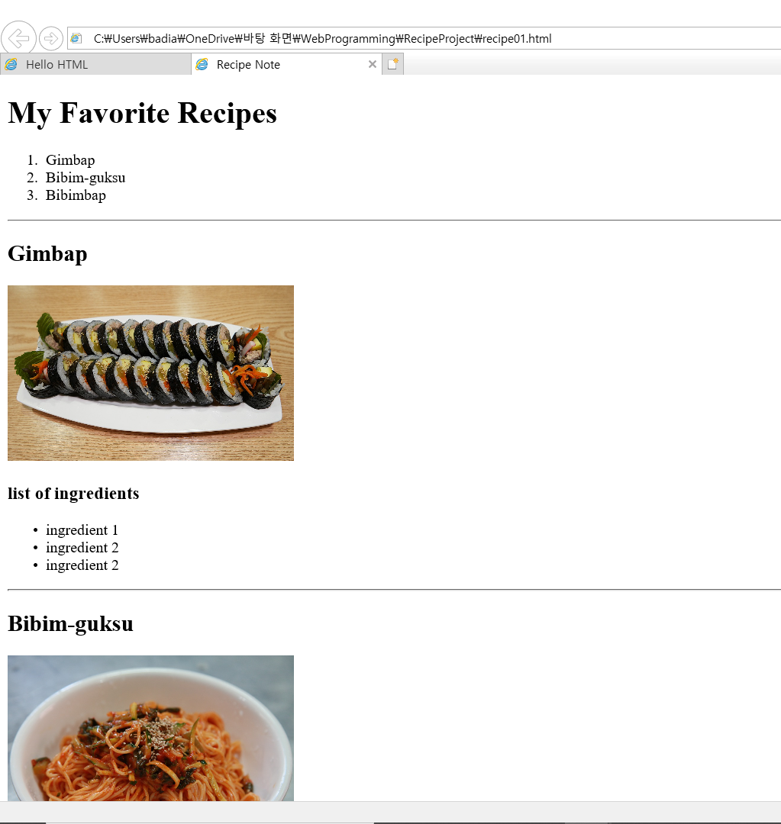
A few tags to learn
<h1></h1>
<h1> ~ <h6>
<img>
src
alt
width
<hr>
<ul></ul>, <ol></ol>, <li></li>
type: A, a, I, i

Slide 20
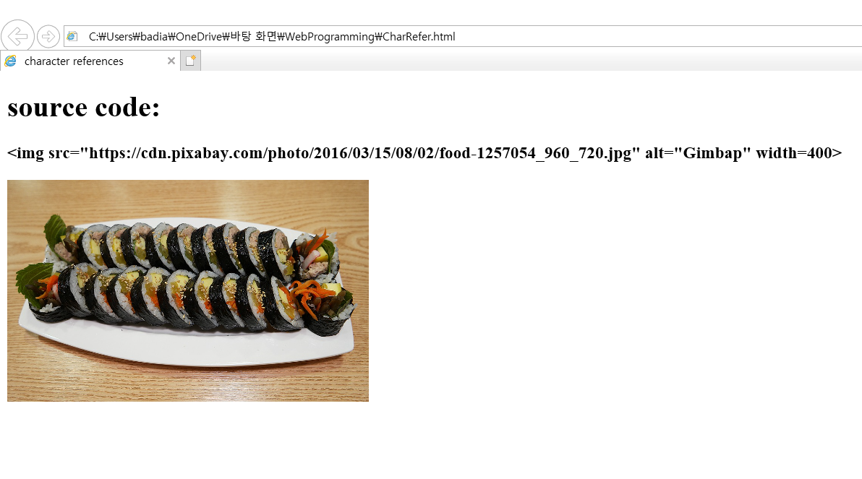
character references
Symbol | Entity Name
less than '<' | &lt;
greater than '>' | &gt;
ampersand '&' | &amp;
non-breaking space | &nbsp;
quotes " | &quot;

Slide 21
Check Points
Match open tags and close tags
Proper indentation
https://contribute.jquery.org/style-guide/html/
https://google.github.io/styleguide/htmlcssguide.html
Tags are case insensitive
attributes are case sensitive
CamelCase vs. snake_case
Double and single quotes are almost interchangeable, but they have to be matched

Slide 22
Let’s do!
Create your own recipe book

